Slide 1

NAIVE BAYES THEOREM

Slide 2

WHAT IS NAÏVE BAYES THEOREM
Naïve Bayes is a probabilistic machine learning algorithm based on the Bayes Theorem, used in a
wide variety of classification tasks.
Naive Bayes is a machine learning model that is used for large volumes of data, even if you are working with data that has millions of data records the recommended approach is Naive Bayes.
It gives very good results when it comes to NLP tasks such as sentimental analysis. It is a fast and uncomplicated classification algorithm.

Slide 3
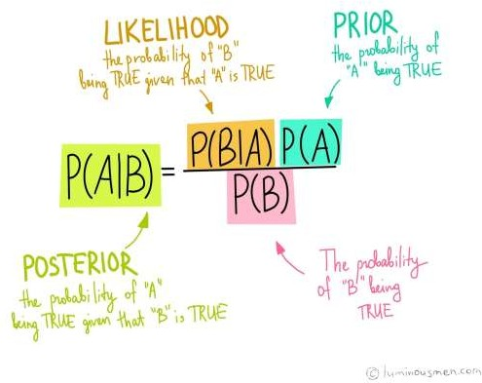
BAYES THEOREM
It is a theorem that works on conditional probability.
Conditional probability is the probability that something will happen, given that something else has already occurred.
The conditional probability can give us the probability of an event
using its prior knowledge.

Slide 4
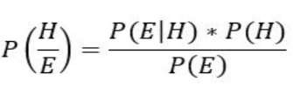
NAIVE BAYES CLASSIFIER
It is a kind of classifier that works on Bayes theorem. Prediction of membership probabilities is made for every class such as the probability of data points associated to a particular class. The class having maximum probability is appraised as the most suitable class. This is also referred as Maximum A Posteriori (MAP).
The MAP for a hypothesis is:
𝑀𝐴𝑃 (𝐻) = max 𝑃((𝐻|𝐸))
𝑀𝐴𝑃 (𝐻) = max 𝑃((𝐻|𝐸) ∗ (𝑃(𝐻)) /𝑃(𝐸))
𝑀𝐴𝑃 (𝐻) = max(𝑃(𝐸|𝐻) ∗ 𝑃(𝐻))
𝑃 (𝐸) is evidence probability, and it is used to normalize the result. Result will not be affected by removing 𝑃(𝐸).
NB classifiers conclude that all the variables or features are not related to each other. Existence or
absence of a variable does not impact the existence or absence of any other variable.

Slide 5
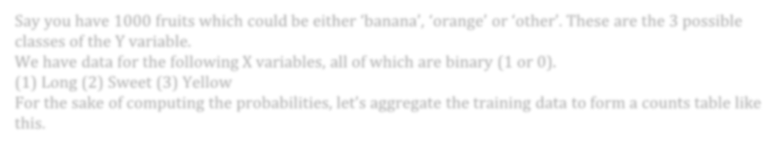


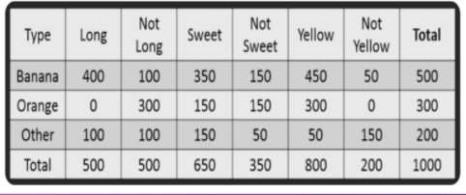
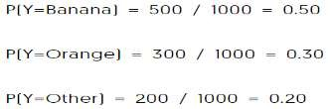
EXAMPLE
Say you have 1000 fruits which could be either ‘banana’, ‘orange’ or ‘other’.
These are the 3 possible classes of the Y variable.
We have data for the following X variables, all of which are binary (1 or 0).
(1) Long (2) Sweet (3) Yellow
For the sake of computing the probabilities, let’s aggregate the training data to form a counts table like
this.
Compute the ‘Prior’ probabilities for each of the class of fruits :-

Slide 6

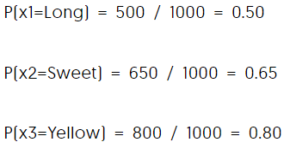
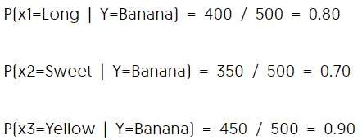
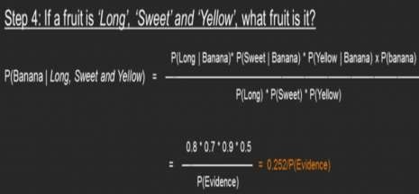
EXAMPLE
Compute the probability of evidence that goes in the denominator
Compute the probability of likelihood of evidences that goes in the numerator.
Probability of Likelihood for
Banana
In the above table, you have 500
Bananas. Out of that 400
is long. So, P(Long | Banana)
= 400/500
= 0.8.
Substitute all the 3 equations into the Naive Bayes formula, to get the probability that it is a banana.

Slide 7
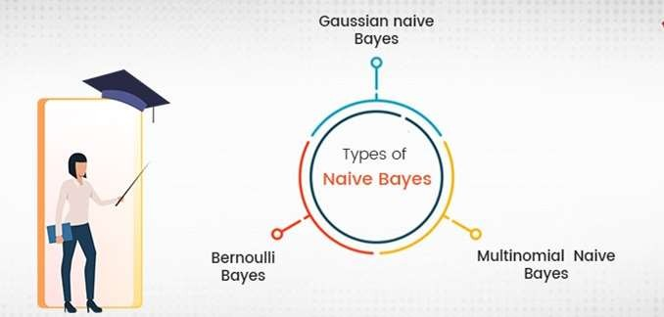
TYPES OF NAÏVE BAYES CLASSIFIER

Slide 8
Gaussian Naïve Bayes:
When characteristic values are continuous in nature then an assumption is made that the values linked with each class are dispersed according to Gaussian that is Normal Distribution.
TYPES OF NAÏVE BAYES
Multinomial Naïve Bayes: Multinomial Naive Bayes is favored to use on data that is multinomial distributed. It is widely used in text classification in NLP. Each event in text classification constitutes the presence of a word in a document.
Bernoulli Naïve Bayes: When data is dispensed according to the multivariate Bernoulli distributions then Bernoulli Naive Bayes is used.That means there exist multiple features but each one is assumed to contain binary value. So, it requires features to be binary valued.

Slide 9
Advantages:
It is a highly extensible algorithm which is very fast
It can be used for both binary as well as multiclass classification.
It has mainly three different types of algorithms that are Gaussian NB,Multinomial NB, Bernoulli NB.
It is a famous algorithm for spam email classification.
It can be easily trained on small datasets and can be used for large volumes of data as well.
Advantages and Disadvantages of
Naïve Bayes
Disadvantages:
The main disadvantage of the NB is considering all the variables
independent that contributes to the probability.

Slide 10

NAÏVE BAYES APPLICATIONS
Applications of Naive Bayes Algorithms
Real time Prediction: Being a fast learning algorithm it can be used to make predictions in real time as well.
Multi Class Classification: It can be used for multi
class classification problems also.
Text Classification: As it has shown good results in predicting multi class classification so it has more success rates compared to all other algorithms. As a result, it is majorly used in sentiment analysis & spam detection.

Slide 11

THANK YOU !

